Slide 1
Augmentative and Alternative Communication
Communication Tools

Slide 2

Checking In

Slide 3
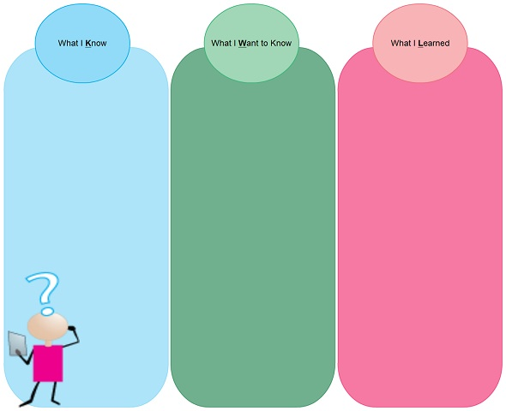

Activity: KWL
Complete chart on own
Put points up on chart paper
If your point is already up, put a check mark beside it

Slide 4
AAC – Communication Tools
Three types of Communication Tools are:
  Social Stories: Describe a situation, skill, or concept in terms of relevant social cues, perspectives, and common responses in a specifically defined style and format. http://youtu.be/vjlIYYbVIrI
  Comic Strip Conversations: Comic strip conversations are a technique developed by Carol Gray to help people with autism develop greater social understanding.

Slide 5
Communication Tools
Choice Boards - A visual tool with two or more possible choices for an individual. These choices may be expressed in pictures, photographs, symbols or written text.
A choice board allows the student time to see all the possibilities and to think about the decisions.
Students have time to check the options as often as needed, before making a decision.

Slide 6

Communication Tools
The fundamental purpose of a choice board is to present a visual display of options.
This strategy aids or supports the comprehension of the auditory message.
By providing additional visual information we ensure that the choice will still be available
after the spoken message is gone.

Slide 7
Communication Tools
More about Social Stories –
Although Social Stories™ were first developed for use with children with ASD, the approach has also been successful with children, adolescents, and adults with ASD and other social and communication delays and differences, as well as individuals developing typically.

Slide 8

Communication Tools
More recently, we have begin using Social Articles™ with adolescents and adults.
These still follow the guidelines and criteria for writing a Social Story™ but are written at a more age-appropriate level and format.
For samples of Social Stories™ and Social Articles™ you can read issues of The Social Stories™ Quarterly.

Slide 9
Communication Tools
Comic strip conversations, also created by Carol Gray, are simple visual representations of the different levels of communication in a conversation.
The terms 'social story' and 'social stories' are trademarks originated and owned by Carol Gray. All rights reserved.
PAY activity in dyads or triads

Slide 10
Communication Tools
For example Comic Strip Conversations could show:
the things that are actually said in a conversation
how people might be feeling
what people's intentions might be.

Slide 11
Communication Tools
Comic Strip Conversations use symbols, stick figure drawings and colour.
By seeing the different elements of a conversation presented visually, some of the more abstract aspects of social communication (such as recognising the feelings of others) are made more 'concrete' and are therefore easier to understand.
Quick link to this page: www.autism.org.uk/16261

Slide 12
Communication Tools
Choice Boards
How: Determine what and how many choices will be placed on the board (if introducing for the first time limit the number of choices and then gradually add choices once the student has had success)
Ensure that the student understands what the visual actually represents and teach this first if necessary
Print photos, pictures, symbols or text that represent each choice. It is recommended that a written text label be included with any pictures, photos or symbols

Slide 13
Communication Tools
Samples of choice boards are available to be downloaded from http://elearning.autism.net/visuals/main.php
Be aware that some individuals may need to have a more random presentation of choices for example, scattered on a table or they may select the first item in the first row of the choice board

Slide 14
Communication Tools
Assignment:
Each group is will develop three (3) Communication Tools based on a provided case study. One of each of the following tools:
Social Story
Comic Strip Conversation
Communication Board

